Slide 1

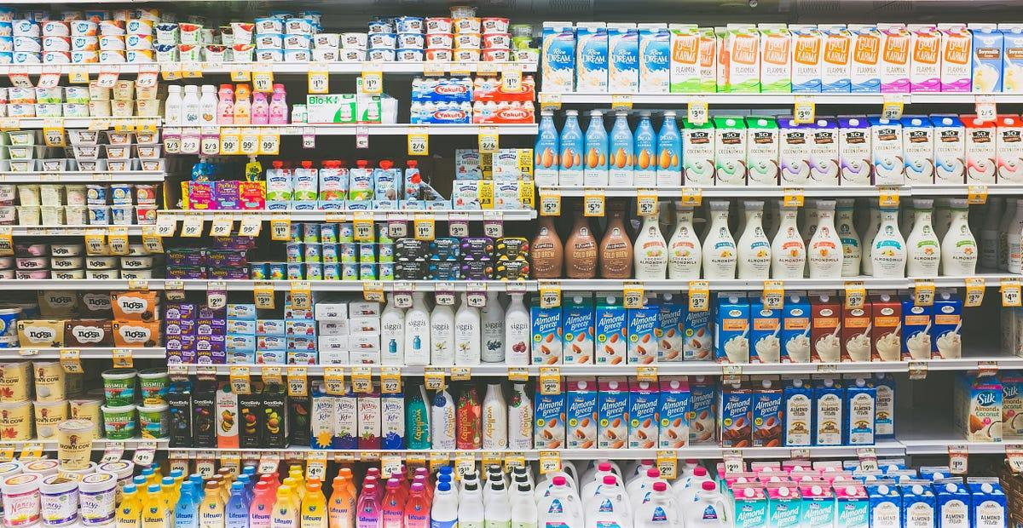
Store Demand Forecasting using Time-Series and Neural Networks
Authors:
Aravinda Raman Jatavallabha, Pankaj Manoharlal Thakur, Suraj Raghu Kumar
North Carolina State University, Raleigh

Slide 2
Introduction
Pivotal role in supply chain management and retail operations.
Preventing stockouts or overstocking.
Optimize inventory levels, allocate resources effectively, and enhance overall operational efficiency.
Neural Networks and time series forecasting techniques play a substantial
Notes:
Speaker Notes: Demand forecasting holds a pivotal role in supply chain management and retail operations.
In the context of retail stores, precise demand forecasting is crucial to ensure the right product quantities are available at the correct time and location, thus preventing stockouts or overstocking.
Neural Networks and time series forecasting techniques play a substantial role in addressing the challenges of demand forecasting.

Slide 3

Goal of the Project
Constructing a forecasting model for predicting future sales in various stores.
Using machine learning algorithms and time series analysis techniques for accurate predictions.
Notes:
In this project Our main goal is to develop a cutting-edge forecasting model leveraging advanced machine learning algorithms and sophisticated time series analysis techniques to deliver precise predictions of future sales across diverse retail outlets. By harnessing the power of data-driven insights, this project aims to revolutionize sales forecasting, empowering businesses to optimize inventory management, streamline resource allocation, and maximize profitability.

Slide 4
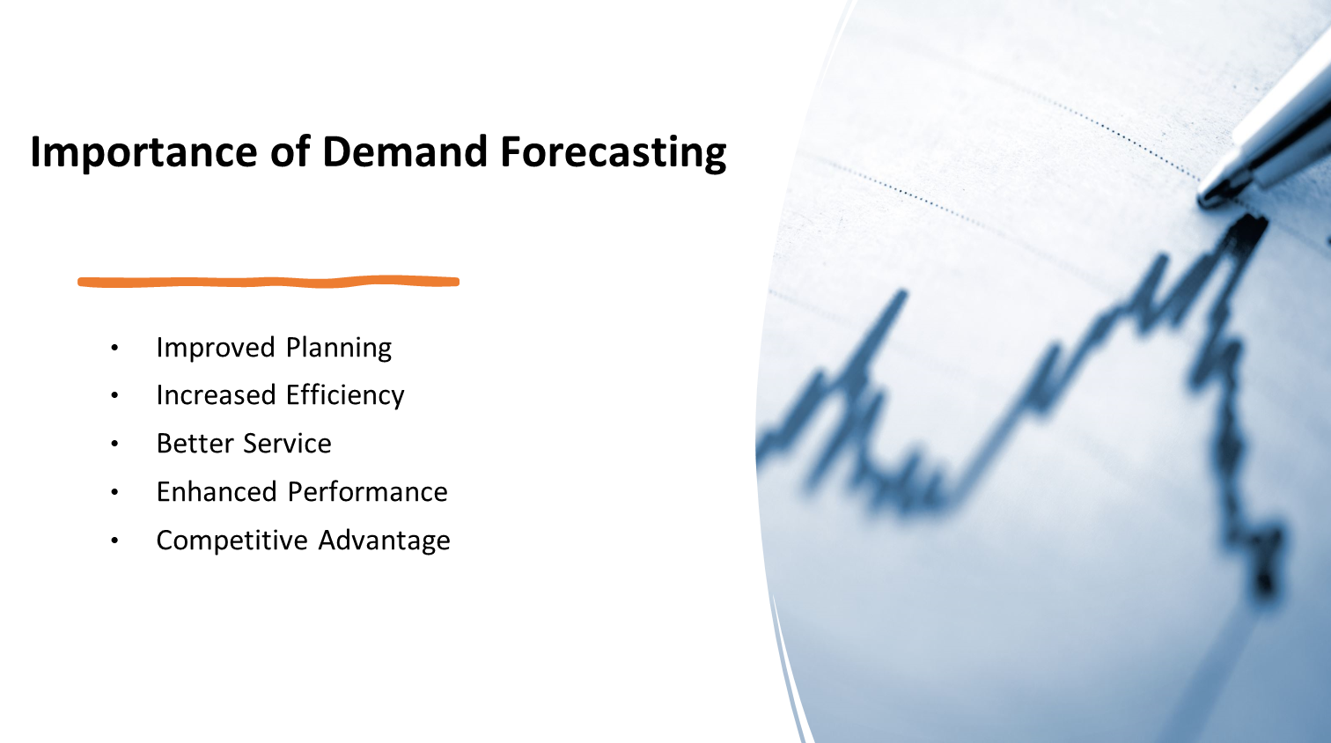

Slide 5
Related works
Authors | Work | Description
A. Krishna, A. V, A. Aich and C. Hegde | Sales-forecasting of Retail Stores using Machine Learning Techniques [1] | The paper compares various machine learning techniques for retail sales forecasting, finding Gradient Tree Boosting to be the most effective. It stresses the importance of accurate forecasting for businesses and the need for proper model selection and hyperparameter tuning.
Y. Ali and S. Nakti | Sales Forecasting: A Comparison of Traditional and Modern Times-Series Forecasting Models on Sales Data with Seasonality [2] | The paper compares traditional and modern time-series forecasting models for sales data, highlighting SARIMA's effectiveness in capturing fast-moving sales with seasonal patterns and LSTM's potential for further enhancement. It emphasizes the importance of accurate forecasting for business planning and the need for selecting models tailored to specific business requirements.
Notes:
These are some of the works done related to our study

Slide 6
Related works
Authors | Work | Description
F. -C. Yuan and C. -H. Lee | Sales Volume Forecasting Decision Models [3] | The paper compares various machine learning techniques for retail sales forecasting, finding Gradient Tree Boosting to be the most effective. It stresses the importance of accurate forecasting for businesses and the need for proper model selection and hyperparameter tuning.
B. Lakshmanan, P. S. N. -V. Raja and V. Kalathiappa | Sales Demand Forecasting Using LSTM Network [4]. | The paper proposes an LSTM-based sales forecasting model, demonstrating its superiority over conventional methods like MLP regressor and linear regression. It achieves 96.77% accuracy with real-time sales data from southern India, offering improved performance and addressing forecasting challenges for businesses.
Notes:
Here are a couple more

Slide 7
Dataset Description
Data Source:
We’ve used data obtained from the Store Item Demand Forecasting Challenge dataset from Kaggle. [5]
It contains 4 attributes related to Date, Store ID, Item ID and Sales (no. of units sold).
Sales were recorded across 10 different stores, for 50 different items from 01/01/2013 to 12/31/2017
Notes:
So this slide provides an overview of our data source and its attributes. We obtained the data from the Store Item Demand Forecasting Challenge dataset available on Kaggle. The dataset includes four key attributes: Date, Store ID, Item ID, and Sales, representing the number of units sold. In total, there are 10 stores and 50 items included in the dataset. Sales were recorded across 10 different stores, for 50 different items from Jan 1st 2013 to Dec 31st 2017

Slide 8
Understanding the Data
DATE | STORE | ITEM | SALES
2013-01-01 | 1 | 1 | 13.0
2013-01-01 | 2 | 3 | 100.0
2013-01-02 | 1. | 1 | 20.0
2013-01-02 | 2 | 3 | 78.0
2014-01-01 | 3 | 2 | 10.0
2014-01-02 | 5 | 38 | 28.0
2014-01-03 | 10 | 50 | 27.0
Notes:
This is a subset of our dataset obtained from Kaggle as mentioned earlier.

Slide 9
Data Preprocessing
Verified absence of duplicates, ensuring data integrity.
Transformed date format for consistency and analysis.
Confirmed null values absence, ensuring data completeness.
Acknowledged weak correlations with sales.
Adopted inclusive approach, incorporating all attributes.
Aimed to leverage interactions for enhanced model efficacy.
Sorted data chronologically, with 75%/25% train/test split.
Notes:
During data preparation, we meticulously ensured data integrity by verifying the absence of duplicates. We standardized date formats for consistency and conducted a thorough check for null values, guaranteeing data completeness. Despite weak correlations with sales, we opted for an inclusive approach, incorporating all attributes to capture potential interactions and dependencies, enhancing model efficacy. Finally, data was sorted chronologically, with a 75%/25% train/test split for robust model evaluation.

Slide 10
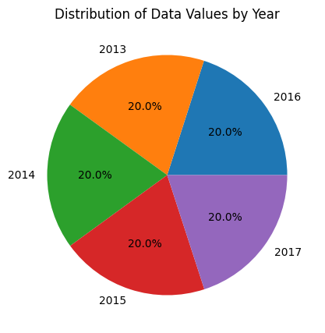
Data Distribution
Notes:
As depicted in the pie chart, our train set exhibits a balanced data distribution across different years, indicating no significant data imbalance. This uniform distribution ensures that each year is adequately represented in our training data, enhancing the robustness and reliability of our model across various time periods.

Slide 11
Pre-Processing: Data Transformation
Independent Vars. | Description | Initial Format | Transformed format | Var. Type
DATE | Scheduled departure, local time | yyyy-mm-dd | 1,2,3….100 | Discrete, Ordinal
STORE | Store ID | 1, 2, 3,...,10 | 0/1 and 1, 2, 3,…, 10 * | Discrete, Ordinal
ITEM | Item ID | 1, 2, 3,....., 50 | 0/1 and 1, 2, 3,…, 50 * | Discrete, Ordinal
* Tried One-hot encoding, but Label Encoded Store IDs turned out better
Notes:
In the pre-processing stage, we focused on transforming our independent variables to ensure compatibility with our models.
DATE variable, representing scheduled departure times, was to a discrete ordinal attribute for the model to interpret it as an independent variable and capture temporal dependencies.
Similarly, for the STORE and ITEM variables were label encoded.

Slide 12






Tools and Technologies used
Notes:
These are some of the tools and technologies we used in our project

Slide 13
Method
Selection of advanced time series models: Bi-LSTM, LSTM+CNN and BiLSTM+CNN chosen for their proficiency in capturing complex temporal patterns.
Incorporation of baseline regression models: Random Forest Classifier, XGBoost, Artificial Neural Network, Convolutional Neural Networks (CNN), ARIMA and LSTM for benchmarking.
Advantages of LSTM and Bi-LSTM: adeptness in handling vanishing gradient problems and capturing long-term dependencies.
Mitigation of vanishing gradient issue: employment of techniques like gradient clipping and batch normalization in LSTM models.
Expected superiority of time series models, especially LSTM and its variants, in predicting sales due to their capacity to capture temporal dependencies, offering valuable insights into machine learning approaches for sales prediction.
Notes:
We chose advanced time series models like Bi-LSTM, LSTM+CNN, and BiLSTM+CNN for their ability to capture complex temporal patterns. Alongside these, we included baseline regression models such as Random Forest Classifier, XGBoost, Artificial Neural Network, Convolutional Neural Networks (CNN), ARIMA, and LSTM for comparison.
LSTM and Bi-LSTM were highlighted for their strengths in handling vanishing gradient problems and capturing long-term dependencies in data. Techniques like gradient clipping and batch normalization were employed to address the vanishing gradient issue in LSTM models.
We anticipate superior performance from time series models, particularly LSTM and its variants, in predicting sales. Their capability to capture temporal dependencies provides valuable insights into sales prediction, improving our understanding of underlying patterns in sales data

Slide 14
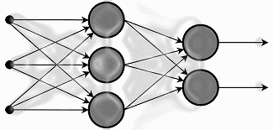
Modeling
The baseline machine learning algorithms used in this study are:
Random Forest Regressor
Convolutional Neural Networks (CNN)
XGBoost Regressor
Artificial Neural Network (ANN)
Notes:
These are some of the baseline models that we used

Slide 15
Modeling
The time-series machine learning algorithms used in this study are:
Long short-term memory (LSTM)
ARIMA
Bidirectional Long Short-Term Memory (BiLSTM)
Notes:
And these are some of the time-series models that we used.

Slide 16
Modeling
Our Final Ensemble Models
LSTM + CNN Hybrid Model
BiLSTM + CNN Hybrid Model
Notes:
These are our final ensemble models which includes a LSTM and CNN hybrid as well as a BiLSTM and CNN hybrid.

Slide 17
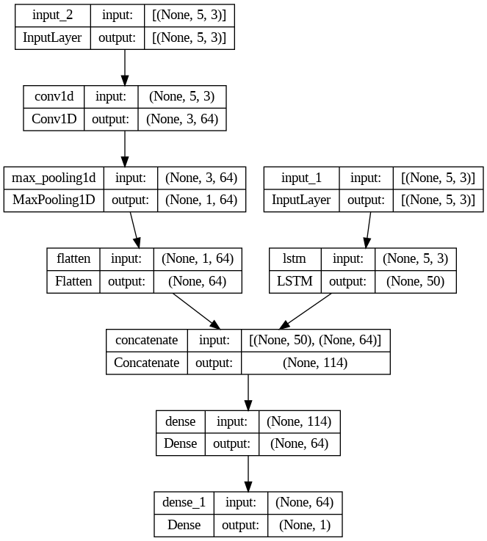
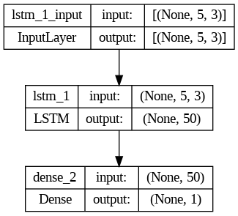
Time-Series Architecture
LSTM/CNN Hybrid (Our model)
LSTM
Hand tuned batch size (256) and LSTM hidden nodes (50)
'Adam' optimizer and ReLU activation function were used
Notes:
The slide showcases two models: a traditional LSTM model on the left and a hybrid LSTM-CNN model on the right. The hybrid model, developed from scratch, combines Convolutional Neural Network (CNN) and Long Short-Term Memory (LSTM) components. In this architecture, the CNN segment convolves over input data, extracting spatial features, while the LSTM captures temporal dependencies. Both pathways then undergo dense layers for feature refinement before their outputs are combined for accurate prediction or classification.
We hand tuned each of these model and a batch size of 256 turned out to be suitable for training.
BiLSTM-CNN which is one our other models also has a similar architecture in which each LSTM layer is just surrounded by a Bidirectional Wrapper.
OPTIONAL SPEAKER NOTES (IF QUESTIONS ARE ASKED)
The LSTM CNN hybrid architecture illustrated above integrates both Convolutional Neural Network (CNN) and Long Short-Term Memory (LSTM) components to leverage their respective strengths in capturing spatial and temporal patterns from input time-series data. The CNN segment initiates by convolving over the input data, extracting relevant spatial features through one-dimensional convolutional operations, followed by max-pooling and flattening layers to distill significant patterns along the temporal dimension. These spatial features are then further refined through a densely connected layer, augmenting their representational capacity. Simultaneously, the LSTM component processes the same input data, specializing in capturing temporal dependencies across sequential observations. Comprising of an LSTM layer, this segment adeptly captures sequential information, with the layer capturing information from the past, and this is followed by a densely connected layer that refines the extracted features from the LSTM pathway. Finally, the outputs from both the CNN and LSTM pathways are concatenated, merging spatial and temporal insights into a unified feature space. This concatenated feature vector encapsulates a comprehensive representation of the input sequence, empowering the model to discern intricate spatial and temporal patterns crucial for accurate prediction or classification tasks

Slide 18
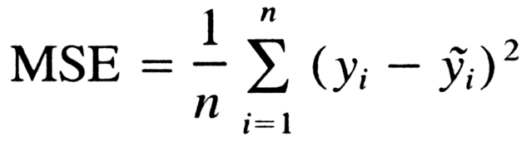
Training and Evaluation Metrics
MSE quantifies the average squared magnitude of errors between predicted and actual values
Useful for training models because it gives higher weighting to lower frequency values.
Mean Squared Error (MSE)
Notes:
We used Mean Squared Error as our training and evaluation metric.
MSE quantifies the average squared magnitude of errors between predicted and actual values
It is also useful for training models because it gives higher weighting to lower frequency values.

Slide 19
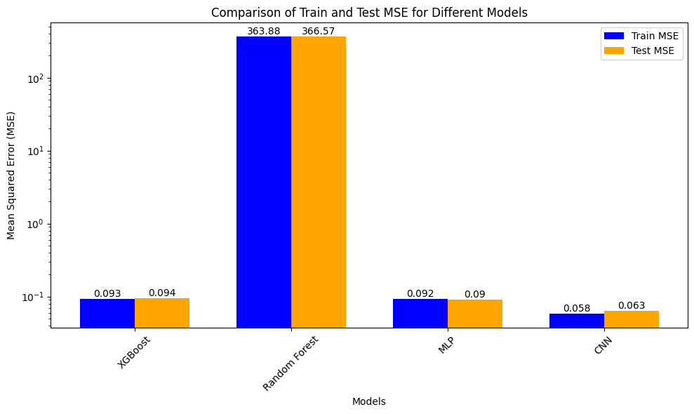
Results: Baseline Models
Notes:
So this graph illustrates the results (MSE) obtained from our baseline (non time-series) models. As we can see, CNN model performs the best followed by MLP and XGBoost

Slide 20
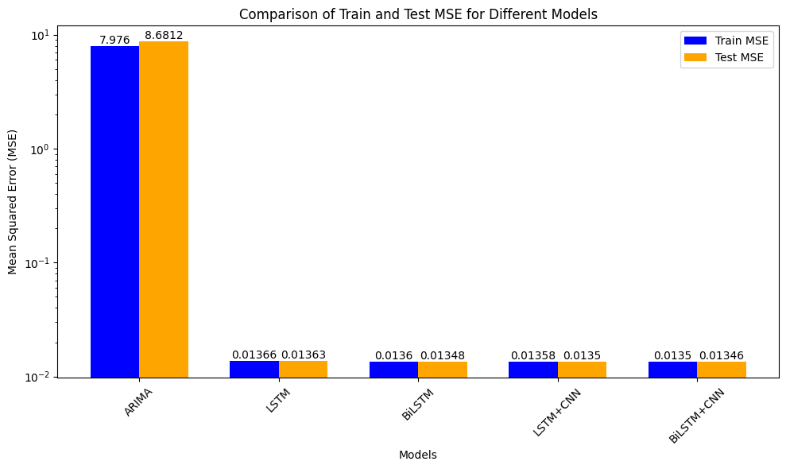
Results: Time-Series Models
Notes:
Contrasting that with our time series approach, we can see that the BiLSTM-CNN hybrid (our model) performs the best on both the training and testing sets closely followed by the BiLSTM and LSTM-CNN models. Although our model has only a slight improvement compared to the traditional BiLSTM model, it is still noteworthy.
Also, it is interesting to see the performance of our ARIMA model compared to others. The poor performance in sales prediction may be attributed to its linear nature, which struggles to capture the complexity of non-linear temporal patterns present in the dataset. In contrast, LSTM and other models excel by inherently capturing and learning from intricate temporal dependencies, leading to superior predictive performance

Slide 21
Discussion and Future Scope
BiLSTM+CNN model showed the best performance in sales prediction.
BiLSTM and LSTM+CNN hybrid models followed, indicating promising results.
Possible issues
Limited Attribute Coverage: The dataset's restriction to only three attributes—Date, Store ID, and Item ID—might have hindered the models' ability to capture the full spectrum of factors influencing sales, potentially overlooking crucial variables such as promotions, competitor activity, or seasonal trends.
Lack of Granularity: With only three attributes available, the dataset may lack the granularity needed to accurately capture the intricacies of sales patterns, potentially leading to oversimplified model representations and reduced predictive accuracy.
In the future, advanced evaluation techniques to assess model performance in capturing temporal dynamics and other complexities of sales data can be explored in addition to obtaining more information on the dataset.
Notes:
The BiLSTM+CNN model demonstrated the highest sales prediction performance, compared to the other models. However, limitations such as limited attribute coverage and lack of granularity in the dataset may have hindered capturing crucial factors like promotions or seasonal trends, potentially reducing predictive accuracy. Future improvements may involve advanced evaluation techniques for temporal dynamics and acquiring additional dataset information.

Slide 22
References
[[1]A. Krishna, A. V, A. Aich and C. Hegde, Sales-forecasting of Retail Stores using Machine Learning Techniques, 2018, 3rd International Conference on Computational Systems and Information Technology for Sustainable Solutions (CSITSS), Bengaluru, India, 2018, pp. 160-166, doi: 10.1109/CSITSS.2018.8768765.
[2] F. Wieland. Limits to growth: results from the detailed policy assessment tool [air traffic congestion]. In 16th DASC. AIAA/IEEE Digital Avionics Systems Conference. Reflections to the Future. Proceedings, volume 2, pages 9.2–1–9.2–8 vol.2, Oct. 1997.
[3] F. -C. Yuan and C. -H. Lee, "Sales Volume Forecasting Decision Models," 2011 International Conference on Technologies and Applications of Artificial Intelligence, Chung Li, Taiwan, 2011, pp. 239-244, doi: 10.1109/TAAI.2011.49. keywords: {Forecasting;Marketing and sales;Genetic algorithms;Support vector machines;Predictive models;Artificial neural networks;Biological cells;Sales volume forecasting;Support vector regression;Genetic algorithm;Artificial neural networks}.
[4] Lakshmanan, B., Vivek Raja, P.S.N., Kalathiappan, V. (2020). Sales Demand Forecasting Using LSTM Network. In: Dash, S., Lakshmi, C., Das, S., Panigrahi, B. (eds) Artificial Intelligence and Evolutionary Computations in Engineering Systems. Advances in Intelligent Systems and Computing, vol 1056. Springer, Singapore. https://doi.org/10.1007/978-981-15-0199-9_11
[5] https://www.kaggle.com/competitions/demand-forecasting-kernels-only
Notes:
These are some our references

Slide 23
THANK YOU

Slide 24
APPENDIX

Slide 25
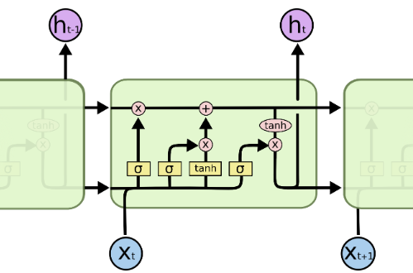
LSTM Model
Long Short-Term Memory (LSTM) models provide a powerful framework for modeling sequential data, such as time series prediction tasks like flight delay prediction.
LSTMs are a type of recurrent neural network (RNN) architecture designed to address the vanishing gradient problem and capture long-term dependencies in sequential data effectively.
The repeating module in an LSTM contains four interacting layers. [7]

Slide 26
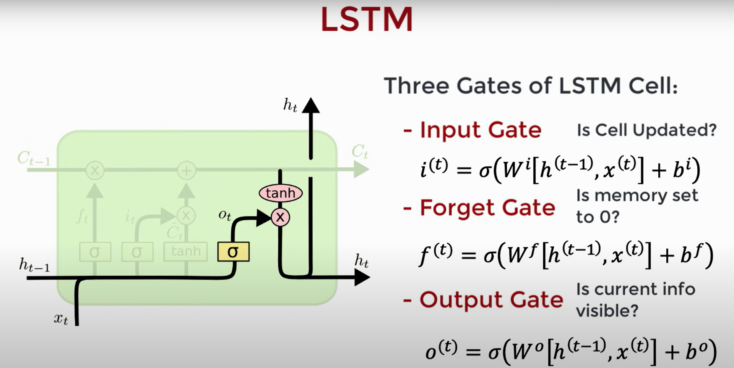
Notes:
In addition to the hidden state vector found in traditional RNN architectures, each LSTM cell maintains a cell state vector. At each time step the next LSTM can choose to read, write or reset the cell using an explicit gating mechanism. Each unit has 3 gates: Input gate - whether memory cell is updated. Forget gate - whether memory cell is reset to 0, Output gate: info of current cell state is visible to the next one. All have sigmoid act as we want the model to be differentiable and constitute of smooth curve. Each of the states takes the current input x and the hidden state h and concatenates the vector and applies a sigmoid.

Slide 27
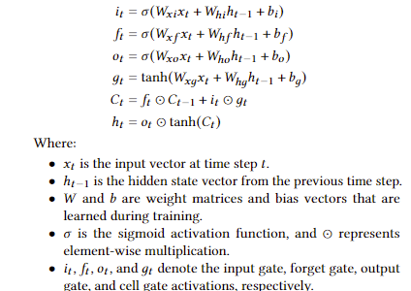
Equations for LSTM

Slide 28
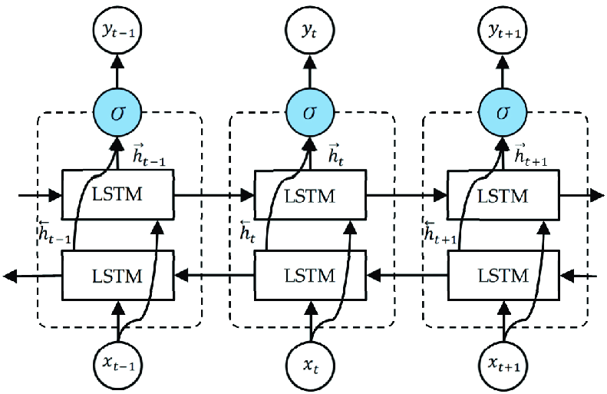
BiLSTM Model
Bidirectional Long Short-Term Memory (BiLSTM) models extend the capabilities of LSTM by processing input sequences in both forward and backward directions.
This allows the model to capture contextual information from both past and future time steps, making it particularly effective for tasks requiring a comprehensive understanding of sequence data.
The unfolded architecture of Bidirectional LSTM (BiLSTM) with three consecutive steps.
Notes:
Bi-LSTM (Bidirectional Long Short-Term Memory) is a type of recurrent neural network (RNN) that processes sequential data in both forward and backward directions. It combines the power of LSTM with bidirectional processing, allowing the model to capture both past and future context of the input sequence.

